Slide 1
PBCST304 Object Oriented Programming
Developing Database applications using JDBC
Prepared by
Renetha J.B.

Slide 2
Topics
JDBC overview
  Creating and Executing Queries(CRUD-CREATE, READ(SELECT), UPDATE, and DELETE
    create table
    delete
    insert
    select

Slide 3
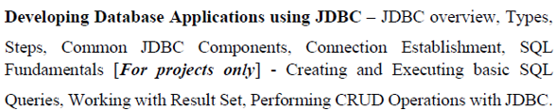

Slide 4
Introduction
Programming Language -Java
  for developing interfaces(front end of an application )
Database–(DBMS software-MySQL , Oracle , PostgreSQL)
  For storing data- (back end of an application)
    Different types- relational database, object based database etc.
  Relational database
    Tabular structure
    E.g. - Oracle, Microsoft Access, MySQL, PostgreSQL, MongoDB etc are RDBMS softwares
SQL- Structured Query Language
  SQL statements are used to perform operations on a database.
  We can insert , delete, update and retrieve data in database using SQL statements.

Slide 5
JDBC overview
JDBC stands for “Java DataBase Connectivity”.
JDBC API (Application Programming Interface) is a Java API that can access any kind of tabular data, especially data stored in a Relational database.
JDBC is used for executing SQL statements from Java program.
With the help of JDBC API, we can insert, update, delete and fetch data from the database.

Slide 6
Why JDBC?
Before JDBC, ODBC(Open DataBase Connectivity) API was the database API to connect and execute the query with the database.
  But, ODBC API uses ODBC driver which is written in C language (i.e. platform dependent and unsecure).
  That is why, Java has defined its own API (JDBC API) that uses JDBC drivers (written in Java language).
If our application is using JDBC API to interact with the database, then we need not change much in our code even if we change the database of our application.

Slide 7
Advantage of JDBC
JDBC standardizes how to do many of the operations like
  connect to the database,
  query the database,
  update the database, and
  call stored procedures.

Slide 8
JDBC architecture
JDBC architecture can be classified in 2 broad categories:-
1. JDBC API
2. JDBC Drivers

Slide 9
Java-JDBC API -JDBC Driver- Database
Java – programming language – coding- Front end
The JDBC API defines a set of interfaces and classes that all major database providers follow
  using JDBC API, Java developers can connect to many Relational Database Management Systems (RDBMS).
  JDBC API uses JDBC drivers to connect with the database.
A JDBC driver is a software component that enables a Java application to interact with specific database.
Database – store data – Back end

Slide 10
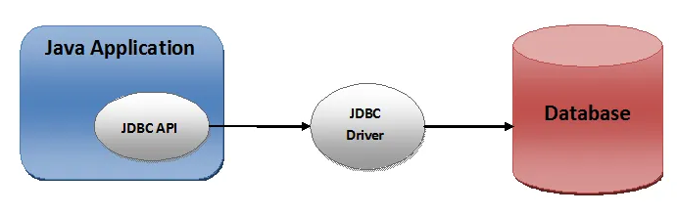

Slide 11
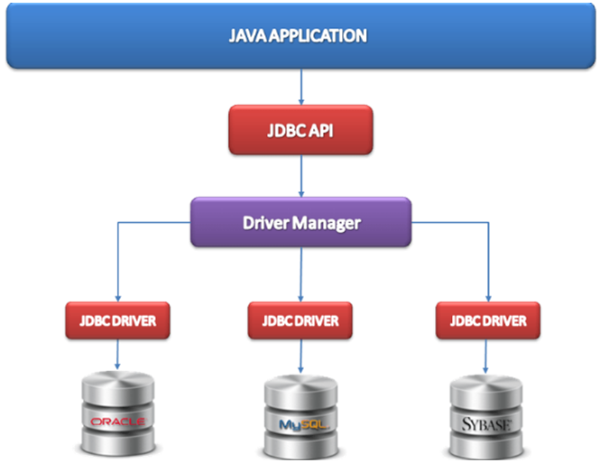

Slide 12
JDBC API
The JDBC API is comprised of two packages:
  java.sql
  javax.sql
These packages contains classes and interfaces for JDBC API.

Slide 13
JDBC API
Some classes and interfaces in java.sql package which support connectivity between Java and database are:
  DriverManager :-"DriverManager class" manages all the Drivers found in JDBC environment, load the most appropriate driver for connectivity.
  Connection: Connection interface objects represents connection and it's object helps to create object of Statement, PreparedStatement etc.
  Statement : :-Statement interface object is used to execute query . It’s value is stored in "ResultSet" object.

Slide 14
JDBC API(contd.)
  PreparedStatement:- represents a precompiled SQL statement .
  Callable Statement:-Callable statement support stored procedure .
  ResultSet: it is used to store the result of SQL query. Java application get the result of database from this ResultSet.
  SQLException:- SQLException class is used to represent error or warning during access from database or during connectivity.

Slide 15
JDBC Drivers
JDBC API uses JDBC drivers to connect with the database.
JDBC drivers .All major vendors provide their own JDBC drivers .
A JDBC driver is a software component that enables a Java application to interact with a database.
JDBC drivers contain a set of java classes that enables to connect to that particular database.

Slide 16
JDBC Drivers
Types Of JDBC Drivers:
JDBC drivers are divided into four types or levels.
  Type 1:
    JDBC-ODBC Bridge driver (Bridge)
  Type 2:
    Native-API/partly Java driver (Native)
  Type 3:
    All Java/Net-protocol driver (Middleware)
  Type 4:
    All Java/Native-protocol driver /Thin Driver (Pure)

Slide 17
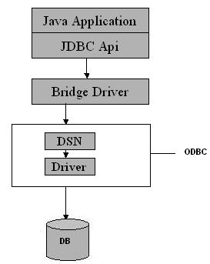
  Type 1 JDBC Driver
The Type 1(JDBC-ODBC Bridge driver) driver translates all JDBC calls into ODBC calls and sends them to the ODBC driver
Advantage
  The JDBC-ODBC Bridge allows access to almost any database, since the database's ODBC drivers are already available.

Slide 18
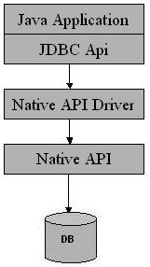
Type 2 JDBC Driver
Type 2 drivers(Native-API/partly Java driver) convert JDBC calls into database-specific calls.

Slide 19
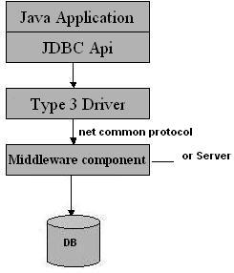
    Type 3 JDBC Driver
Type 3 database driver(All Java/Net-protocol driver) requests are passed through the network to the middle-tier server.
The middle-tier then translates the request to the database.
Advantage
This driver is fully written in Java and hence portable.
It is suitable for the web.

Slide 20
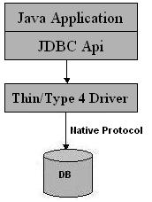
Type 4 JDBC Driver
Type 4 drivers(Native-protocol/all-Java driver) uses java networking libraries to communicate directly with the database server.
Advantage
  They are completely written in Java-platform independent.
  It is most suitable for the web.

Slide 21
Java-Database connectivity
Basic Steps fo connecting Java and database
Before we can create a java JDBC connection to the database, we must first import the java.sql package using:-
import java.sql.*;
  Steps for connecting Java and database are:
    Load and Register a database driver
    Establish(create) a connection to the database
    Create Statement object
    Execute the SQL Statements
    Process the result
    Close the connection and Statement

Slide 22
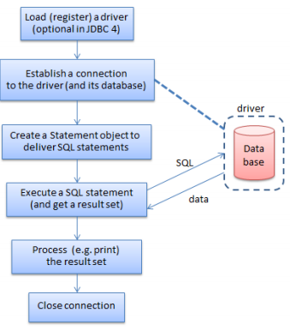

Slide 23
Steps to develop JDBC application:
  Load and Register Driver
  Establish the connection between java application and database
  Creation of statement object
  Send and execute SQL query
  Process Result from ResultSet
  Close the connection and statement.

Slide 24
Java Database Connectivity steps
1. Load or register a database driver
  We can load /register a driver in Java in one of two ways:
    Class.forName(String driver)
    DriverManager.registerDriver(new constructor of the driver )
  We can load the driver class by calling Class.forName() with the Driver class name as an argument or DriverManager.registerDriver() with constructor of the driver class as argument
    Once loaded, the Driver class creates an instance of itself.
    JDBC-ODBC Bridge driver is commonly used.
  Each database has its own driver.
  The JDBC Driver class for MySQL database are
    com.mysql.jdbc.Driver
    com.mysql.cj.jdbc.Driver

Slide 25
Java Database Connectivity
The code for loading MySQL database driver from Java
Class.forName("com.mysql.cj.jdbc.Driver");
or
DriverManager.registerDriver(new com.mysql.cj.jdbc.Driver());

Slide 26
Java Database Connectivity(contd.)
  2. Establish the connection between Java application and database
  The getConnection() method of DriverManager class is used to establish connection with the database.
public static Connection getConnection(String url ,String name, String password) throws SQLException
Connection con=DriverManager.getConnection ( "jdbc:mysql://localhost:3306/ABC" , "root" , "root123" );
JDBC url
password
username

Slide 27
Java Database Connectivity(contd.)
A JDBC URL provides a way of identifying a database so that the appropriate driver will recognize it and establish a connection with it.
The standard syntax for JDBC URLs is:
jdbc:<subprotocol>:<subname>
A JDBC URL has three parts, which are separated by colons:
  jdbc is the protocol.
  <subprotocol> is usually the driver or the database connectivity mechanism, which may be supported by one or more drivers.
  <subname> is the database.
  For example, to access a MySQL database through a JDBC-ODBC bridge, one might use a URL such as the following:
  jdbc:mysql://localhost:3306/ABC

Slide 28
Java Database Connectivity(contd.)
  Connection con=DriverManager.getConnection( "jdbc:mysql://localhost:3306/databasename" , "username", "password" );
  The JDBC url used is
  jdbc:mysql://localhost:3306/databasename
    Here jdbc is the API,
    mysql is the database,
    localhost is the server name on which mysql is running(we can give IP address here)
    3306 is the port number
    databasename is the name of the database created in MySQL
  username Give the username of MySQL(root is the default username. Other MySQL username also we can give here).
  password Give the password of MySQL login given during installation.

Slide 29
Java Database Connectivity(contd.)
  3. Creating a Statement object
  Once a connection is established, we can interact with the database.
  To execute SQL statements, we need to create a Statement object from the Connection object by using the createStatement() method.
  A Statement object is used to send and execute SQL statements to a database.
Statement object= connectionobject. createStatement();
E.g.
Connection con=DriverManager.getConnection( "jdbc:mysql://localhost:3306/ABC" , "root" , "root123" );
Statement st = con.createStatement();
  Statement object st is used to send and execute SQL statements to a database.

Slide 30
Java Database Connectivity(contd.)
  4. Execute the SQL Statements
To execute a SQL statement we use executeQuery() or executeUpdate() method on Statement object.
  The executeUpdate() method executes the CREATE, INSERT, DELETE and UPDATE statements.
    E.g.:
  st.executeUpdate("CREATE TABLE stud1(roll int, name varchar(15))");
  st.executeUpdate(“INSERT INTO student values(1, ’Anu’) ”);
  The executeQuery() method executes a SELECT query
    it takes an SQL SELECT query string as an argument and returns the result(output) as a ResultSet object.
    E.g.:
    ResultSet rs=st.executeQuery(“SELECT rollno, name from student”);

Slide 31
Java Database Connectivity(contd.)
5. Process the ResultSet (in the case of SELECT query only -To Retrieve the Result)
  The result of SELECT query (retrieves data from database) is stored in ResultSet object.
  To retrieve the data from the ResultSet object, we have to use ResultSet’s getxxx() method (where xxx is the data type. )
    public int getxxx(int columnIndex):
    public int getxxx(Stringt columnIndex):
    getInt() to retrieve a integer value.
    getString() method can be used to retrieve a string value.
    getFloat() method can be used to retrieve a floating point value.

Slide 32
Java Database Connectivity(contd.)
Eg:
    ResultSet rs=st.executeQuery(“SELECT rollno, name from student”);
while(rs.next())
{
System.out.println(rs.getInt(1)); System.out.println(rs.getString(2));
}
  Here rs contains all rollno and name rows in studenttable
  ResultSet cursor is initially positioned before the first row;
    the first call to the method next() (rs.next()) moves the cursor forward and makes the first row the current row)
    the second call to next() moves the cursor forward and makes the second row as the current row, and so on.

Slide 33
Java Database Connectivity(contd.)
  rs.getInt(1) will retrieve the value of first attribute in the current row(getInt() is used because first attribute is rollno which is integer)
  rs.getString(2) will retrieve the value of second attribute in the current row(getString() is used because second attribute is name which is character string)

Slide 34
Java Database Connectivity(contd.)
    ResultSet rs=st.executeQuery(“SELECT rollno, name from student”);
while(rs.next())
{
System.out.println(rs.getInt(1)); System.out.println(rs.getString(2));
}
Working:
Here rollno and name in all rows in student table are retrieved.
ResultSet object rs maintains a cursor that is initially positioned before the first row.
When while(rs.next()) is first executed the cursor moves forward to first row of result and prints the value of first attribute (rollno) and second attribute(name)in first row in the result
Next time while loop is executed, if second row is there, then rs.nex() moves cursor to second row and prints the values in thar row.
This continues until there is no more row in the result.

Slide 35
Java Database Connectivity(contd.)
6. Close the connection and Statement
Finally open connections need to be closed using close() method as:
con.close()
st. close()

Slide 36
Java Database connection steps
  1. Load and Register Driver Class.forName("com.mysql.cj.jdbc.Driver");
  Establish the connection between java application and database.
    3. Create Statement object
    Statement st = con.createStatement();
    4. Execute the SQL Statements
    st.executeUpdate(“Create statement/ insert statement/update statement/ delete statement");
ResultSet rs=st.executeQuery(“Select statement");
5.Process the result - using getxxx() xxx can be Int Float String based on data in ResultSet
    6. Close the connection and Statement
con.close();
st. close();
  Connection con=DriverManager.getConnection( "jdbc:mysql://localhost:3306/ABC" ,
  "root" , "root123" );

Slide 37
MySQL
MySQL is an open source database software.
  We can create databases, tables etc for storing data and we can perform various database operations.
Take mysqlshell and type:
\sql
\connect root@localhost
Enter password root123 (password given during installation)
Create database
CREATE DATABASE ABC;
Use the database for creating tables
USE ABC;
Now you can do database operations in MySQL

Slide 38
SQL Commands- CREATE TABLE
CREATE TABLE tablename (atribute1 type, attribute2 type, attribute3 type Primary Key,….. atributen type,constraints);
  Type can be
    int
    char(size)
    varchar(size)
    real
    date
E.g. CREATE TABLE person(name varchar(15) , age int);

Slide 39
SQL Commands- INSERT
Insert rows(values of attribute) into table.
INSERT INTO tablename (attribute,attribute..) VALUES( value1,value2,….);
If type of attribute is varchar or char its value should be enclose in single quotes.
E.g. Insert the following details into Person table
Name is Anu Age 20, Name is Smith Age 10 ,
Name is Roy Age 70
INSERT INTO Person(name,age) VALUES(‘Anu’, 20);
INSERT INTO Person(name,age) VALUES(‘Smith’, 10);
INSERT INTO Person(name,age) VALUES(‘Roy’, 70);

Slide 40
SQL Commands- DELETE
Delete from table.
DELETE FROM tablename WHERE condition;
Condition can be of the form:
  Attribute=value Attribute<value Attribute>value
  Attribute<=value Attribute>=value Attribute!=value
  Attribute BETWEEN value 1AND value2
  If more than one condition is there, then they can be combined using AND , OR as required.
E.g. . Remove details of persons having age 20
DELETE FROM Person WHERE age=20;
Remove details of persons having name Smith or age more than 60
DELETE FROM Person where age>60 OR name=‘Smith’;

Slide 41
SQL Commands - UPDATE
To update or modify the contents in table.
UPDATE tablename SET attribute=value , attribute=value WHERE condition;
Condition can be of the form:
  Attribute=value Attribute<value Attribute>value
  Attribute<=value Attribute>=value Attribute!=value
  Attribute BETWEEN value 1AND value2
  If more than one condition is there, then they can be combined using AND , OR as required.
E.g. Change the age of Roy to 25
UPDATE Person SET age=25 WHERE name=‘Roy’;

Slide 42
SQL Commands - SELECT
To select or retrieve content from table.
SELECT attribute1, attribute2,….. attributen FROM tablename WHERE condition;
Condition can be of the form:
  Attribute=value Attribute<value Attribute>value
  Attribute<=value Attribute>=value Attribute!=value
  Attribute BETWEEN value 1AND value2
  If more than one condition is there, then they can be combined using AND , OR as required.
E.g. Display name and age of persons with age more than 10.
SELECT name, age FROM Person WHERE age>10;

Slide 43
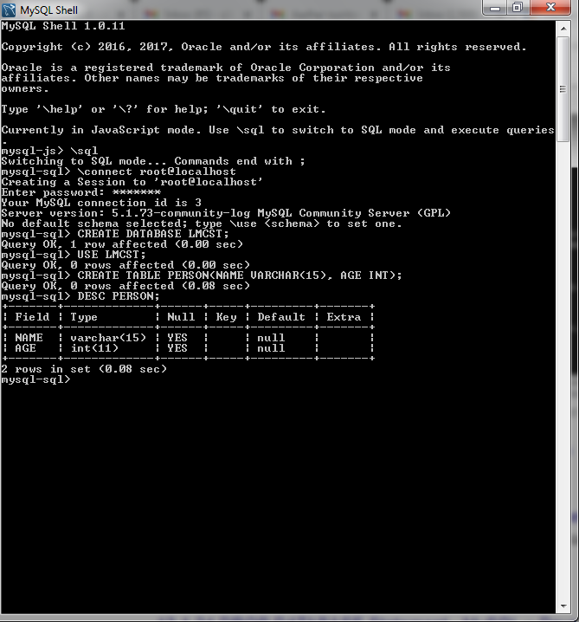

Slide 44
Creating and Executing Queries
Performing CRUD(Create Read(Select) , update and Delete)
CREATE TABLE
DELETE
INSERT
SELECT.

Slide 45
CREATE TABLE in MySQL from Java
Write a Java program to create a table named Student with fields rollno and name in the database ABC
Attribute | Domain type
rollno | int
name | Varchar(15)

Slide 46
Create table from Java
import java.sql.*;
public class CreateTableEg
{ public static void main(String args[]) throws ClassNotFoundException
{
try {
// Register JDBC driver
Class.forName("com.mysql.jdbc.Driver");
//Open a connection
Connection con=DriverManager.getConnection( "jdbc:mysql://localhost:3306/ABC" , "root","root123");
//Create a statement object
Statement st=con.createStatement();
st.executeUpdate("CREATE TABLE Student (rollno int, name varchar(15))");
System.out.println("Table created");
con.close(); //Close the connection
}catch(SQLException e) { System.out.println("Error is " +e); }
}
}

Slide 47
INSERT row using Java
Write a Java program to insert the following row into Student table with fields rollno and name in the database ABC
1 | Anu

Slide 48
INSERT row using Java
import java.sql.*;
public class InsertEg
{ public static void main(String args[]) throws ClassNotFoundException
{
try {
// Register JDBC driver
Class.forName("com.mysql.jdbc.Driver");
//Open a connection
Connection con=DriverManager.getConnection( "jdbc:mysql://localhost:3306/ABC" , "root","root123");
//Create a statement object
Statement st=con.createStatement();
st.executeUpdate("INSERT INTO Student(rollno,name) VALUES (1,'Anu')");
System.out.println(“Data inserted successfully");
st.close();
con.close(); //Close the connection
}catch(SQLException e) { System.out.println("Error is " +e); }
}
}

Slide 49
To access value of java variable inside the SQL command use : SinglequoteDoublequote+varaiable+DoublequoteSinglequote
E.g.
int roll=2;
String nam=“Anu”;
st.executeUpdate("INSERT INTO Student(rollno,name)
VALUES('"+ roll +"' , '"+ nam +"' )");

Slide 50
INSERT row using Java
Write a Java program to insert details about n students into Student table with fields rollno and name in the database ABC

Slide 51
INSERT n rows from Java
import java.sql.*; import java.util.*;
public class CreateTableEg
{ public static void main(String args[]) throws ClassNotFoundException
{ try { Scanner sc=new Scanner(System.in);
int roll,n,i;
String nam;
Class.forName("com.mysql.jdbc.Driver");
Connection con=DriverManager.getConnection( "jdbc:mysql://localhost:3306/ABC" , "root","root123");
Statement st=con.createStatement();
System.out.println("Enter how many students detail to be inserted");
n=sc.nextInt();
for(i=0;i<n;i++)
{ System.out.println("Enter the rollno");
roll=sc.nextInt();
System.out.println("Enter the name");
sc.nextLine();
nam=sc.nextLine();
st.executeUpdate("INSERT INTO Student(rollno,name)
values('"+ roll +"' , '"+ nam +"' )");
} System.out.println(“Data inserted successfully");
st.close();
con.close();
}
catch(SQLException e)
  {
  System.out.println(e);
  }
}
}

Slide 52
DELETE rows using Java
Write a Java program to delete details about students into Student table with given roll number.

Slide 53
DELETE rows using Java
import java.sql.*; import java.util.*;
public class InsertEg
{ public static void ma n(String args[]) throws ClassNotFoundException
{ int roll;
Scanner sc=new Scanner(System.in);
try { Class.forName("com.mysql.jdbc.Driver");
Connection con=DriverManager.getConnection( "jdbc:mysql://localhost:3306/ABC" , "root","root123");
Statement st=con.createStatement();
System.out.println("Enter the rollno of student to be deleted");
roll=sc.nextInt();
st.executeUpdate("DELETE FROM Student WHERE rollno='"+ roll +"' ");
System.out.println("Data deleted succesfully.");
st.close();
con.close(); }catch(SQLException e) { System.out.println("Error is " +e); }
} }

Slide 54
UPDATE rows using Java
Write a Java program to update the name of a student for the specific roll number
Eg.change roll number 1 name to John in Student table

Slide 55
UPDATE rows using Java
import java.sql.*; import java.util.*;
public classUpdateEg
{ public static void main(String args[]) throws ClassNotFoundException
{ Scanner sc=new Scanner(System.in);
int roll; String nam;
try { Class.forName("com.mysql.jdbc.Driver");
Connection con=DriverManager.getConnection( "jdbc:mysql://localhost:3306/ABC" , "root","root123");
Statement st=con.createStatement();
System.out.println("Enter the rollno of student ");
roll=sc.nextInt(); sc.nextLine();
System.out.println("Enter the name of new student "); nam=sc.nextLine();
st.executeUpdate("UPDATE Student SET name='"+ nam +"' WHERE rollno='"+ roll +"' ");
st.close(); con.close(); }catch(SQLException e) { System.out.println("Error is " +e); }
}
}

Slide 56
SELECT rows using Java
Write a Java program to list all names and roll numbers in Student table

Slide 57
SELECT rows Using Java
import java.sql.*;
public class InsertEg
{ public static void main(String args[]) throws ClassNotFoundException
{
try {
Class.forName("com.mysql.jdbc.Driver");
Connection con=DriverManager.getConnection( "jdbc:mysql://localhost:3306/ABC" , "root","root123");
Statement st=con.createStatement();
ResultSet rs=st.executeQuery("SELECT rollno,name FROM student");
while(rs.next())
{ System.out.println(rs.getInt(1)+" "+rs.getString(2));
}
con.close();
}catch(SQLException e) { System.out.println("Error is " +e); }
}
}
Import classes and interfaces from java.sql package
Load the Driver for MySQL
Establish connection
Create statement
Execute Query and represent result as result set
First column
Second column
Close the connection
Load the Driver for MySQL

Slide 58
SELECT rowsUsing Java
import java.sql.*;
public class InsertEg
{ public static void main(String args[]) throws ClassNotFoundException
{
try {
Class.forName("com.mysql.jdbc.Driver");
Connection con=DriverManager.getConnection( "jdbc:mysql://localhost:3306/ABC" , "root","root123");
Statement st=con.createStatement();
ResultSet rs=st.executeQuery("select rollno,name from student");
while(rs.next())
{
System.out.println(rs.getInt(1)+" "+rs.getString(2));
}
con.close();
}catch(SQLException e) { System.out.println("Error is " +e); }
}
}

Slide 59
WORKING
In this example we used MySQL as the database.
Class.forName() is used for loading the Driver class
Driver class: The driver class for the mysql database is com.mysql.jdbc.Driver.
DriverManager.getConnection() helps to establish the connection
  Connection URL: The connection URL for the mysql database is jdbc:mysql://localhost:3306/ABC where jdbc is the API, mysql is the database, localhost is the server name on which mysql is running, we may also use IP address, 3306 is the port number and ABCis the database name. We may use any database in MySQL here.
  Username: The default username for the mysql database is root.
  Password: It is the password given by the user at the time of installing the mysql database.

Slide 60
WORKING(contd.)
  Connection con=DriverManager.getConnection( "jdbc:mysql://localhost:3306/ABC" , "root" , "root123" );
  The JDBC url used is
  jdbc:mysql://localhost:3306/ABC
    Here jdbc is the API,
    mysql is the database,
    localhost is the server name on which mysql is running(we can also give IP address here)
    3306 is the port number
    ABC is the database name created in MySQL (give your database name here)
  root is the username of MySQL(root is the default username . Other MySQL username we can give here).
  root123 is the password of MySQL given during installation(give password you gave during installation)

Slide 61
WORKING(contd.)
Statement st=con.createStatement(); // con is the Connection object
  Statement object st is created from the Connection object con using the method createStatement(). st can be used to send and execute SQL statements to a database.
To execute a SQL statement SELECT we use executeQuery() method on Statement object .
(Note:To execute a SQL commands CREATE TABLE, INSERT, DELETE , UPDATE we use executeUpdate() method on Statement object. )
ResultSet rs=st.executeQuery("SELECT rollno, name FROM Student");
  SELECT command is executed using executeQuery() method on Statement object st.
  Result of this SELECT is the rows containing all rollno and name from the table Student in the form of ResultSet.
  ResultSet object rs maintains a cursor that is initially positioned before the first row in the result of SELECT command.

Slide 62
WORKING(contd.)
    ResultSet rs=st.executeQuery(“SELECT rollno, name FROM student”);
while(rs.next())
{
System.out.println(rs.getInt(1)); System.out.println(rs.getString(2));
}
ResultSet object rs maintains a cursor that is initially positioned before the first row in the result.
When while(rs.next()) is first executed the cursor moves forward to first row of result
  System.out.println(rs.getInt(1)); prints the value of first attribute (rollno)
  System.out.println(rs.getString(2)); prints the value of second attribute (name) in the result
Next time while loop is executed, if second row is there, then rs.nex() moves cursor to second row and prints the values in that row.
This continues until there is no more row in the result.
con.close(); closes the connection

Slide 63
WORKING(contd.)
    ResultSet rs=st.executeQuery(“SELECT rollno, name FROM student”);
while(rs.next())
{
System.out.println(rs.getInt(1)); System.out.println(rs.getString(2));
}
Working:
Here rollno and name in all rows in student table are retrieved.
ResultSet object rs maintains a cursor that is initially positioned before the first row in the result.
When while(rs.next()) is first executed the cursor moves forward to first row of result and prints the value of first attribute (rollno) and second attribute(name)in first row in the result
Next time while loop is executed, if second row is there, then rs.nex() moves cursor to second row and prints the values in that row.
This continues until there is no more row in the result.
con.close(); closes the connection

Slide 64
WORKING(contd.)
ClassNotFoundException , SQLException and other exceptions may occur during these steps.
ClassNotFoundException is thrown from main function
public static void main(String args[]) throws ClassNotFoundException
Using try catch other exceptions like SQLException can be handled
try{
}catch(SQLException se)
{ }
catch(Exception e)
{ }

Slide 65
SELECT rows based on conditionusing Java
Write a Java program to list name of the student in Student table having given roll number

Slide 66
SELECT row based on condition Using Java
import java.sql.*;
import java.util.*
public class InsertEg
{ public static void main(String args[]) throws ClassNotFoundException
{ try { int roll;
Scanner sc=new Scanner(System.in);
Class.forName("com.mysql.jdbc.Driver");
Connection con=DriverManager.getConnection( "jdbc:mysql://localhost:3306/ABC" , "root","root123");
Statement st=con.createStatement();
System.out.println("Enter the rollno of student ");
roll=sc.nextInt();
ResultSet rs=st.executeQuery("SELECT name FROM student WHERE rollno='"+ roll +"' ");
System.out.println("Name of student is “+rs.getString(1));
con.close();
}catch(SQLException e) { System.out.println("Error is " +e); }
}
}

Slide 67
Summary
Programming Language -Java
  for coding, developing interfaces(front end of an application )
Database–(DBMS softwares:MySQL , Oracle , PostgreSQL)
  For storing data- (back end of an application)
  Relational database -Tabular structure
    E.g. - Oracle, Microsoft Access, MySQL, PostgreSQL, MongoDB etc
SQL- Structured Query Language
  SQL statements are used to perform operations on a database. CREATE TABLE, INSERT, DELETE, UPDATE, SELECT

Slide 68
Thank You

